Slide 1

European ATM Architecture – Informed Optimisation
Integrated EA Conference, 3rd March 2015
London

Slide 2

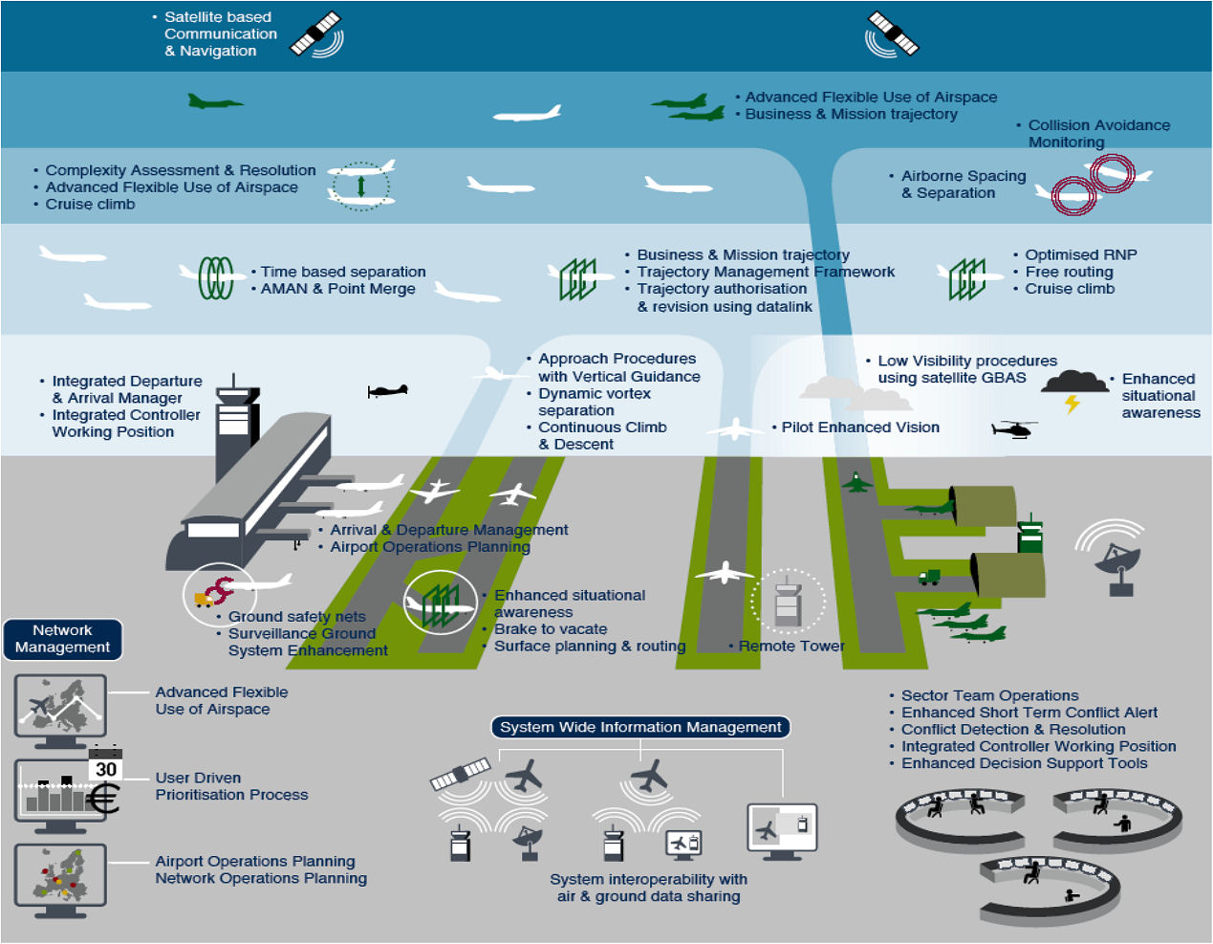
Single European Sky ATM Research
300 Projects
2.1 Billion Euros

Slide 3
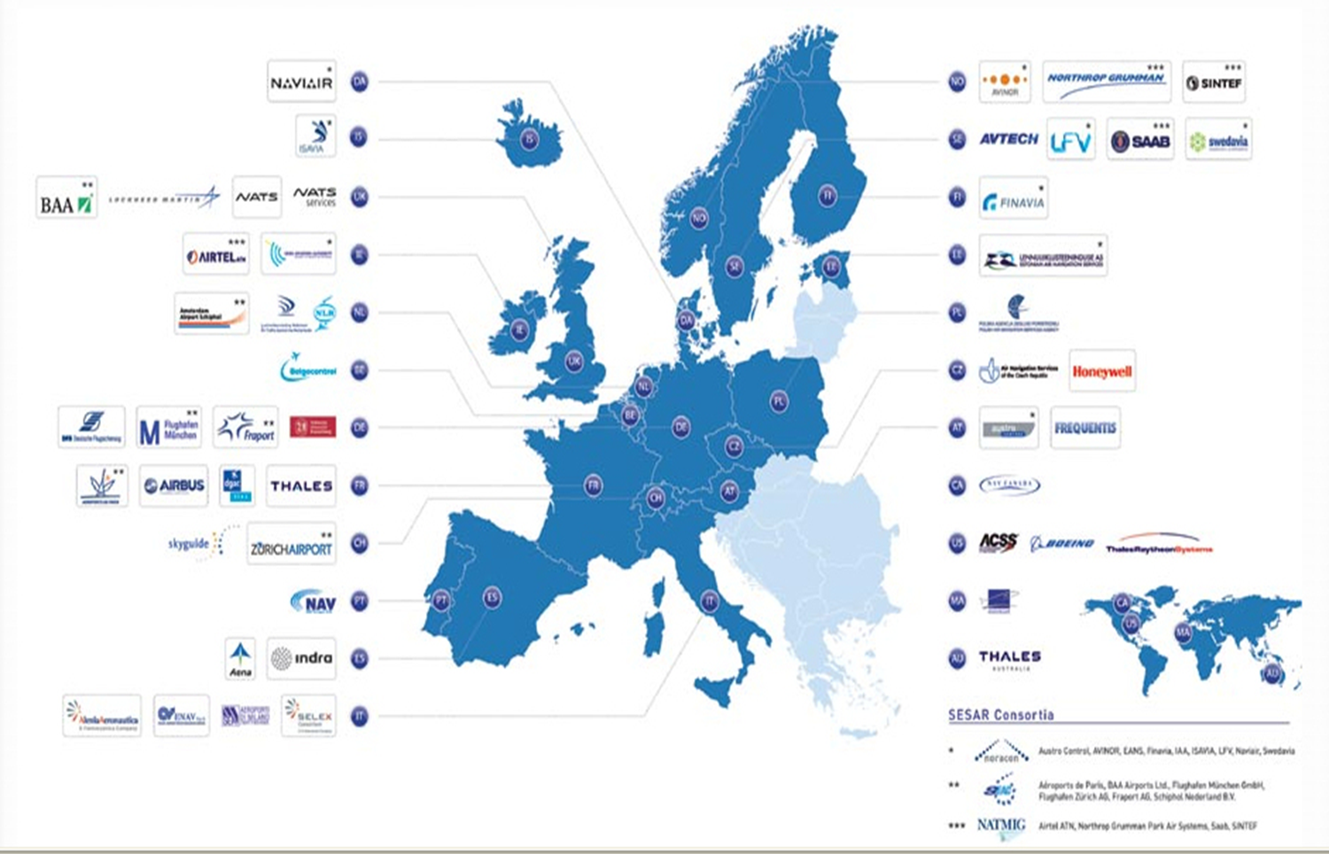
30 Billion Euros
Deployment

Slide 4
Purpose of the
European ATM Architecture
Structure and Optimise R&D
To aid decision making
Optimise deployment of SESAR concepts
4
Notes:
4

Slide 5
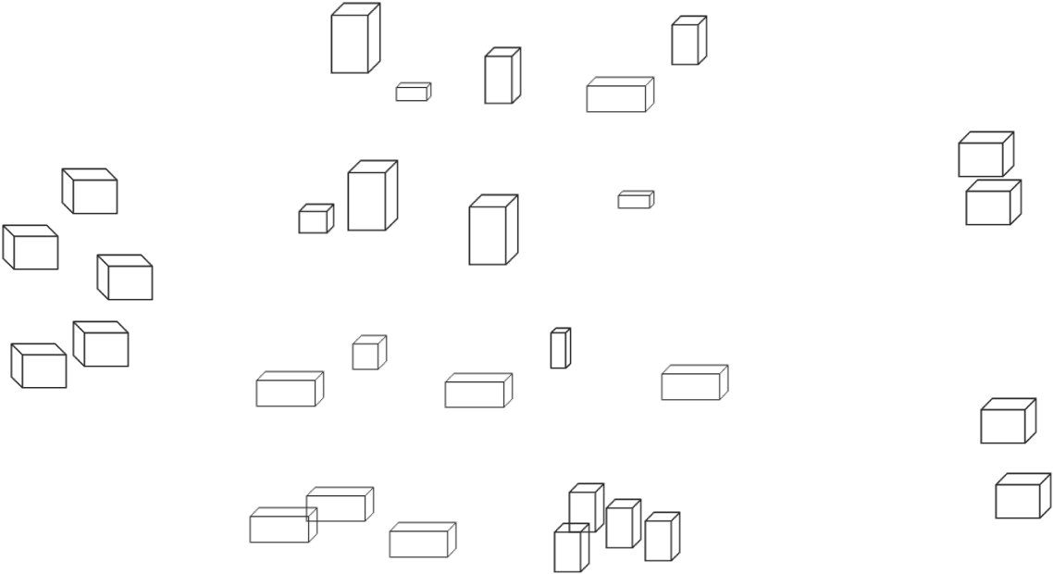

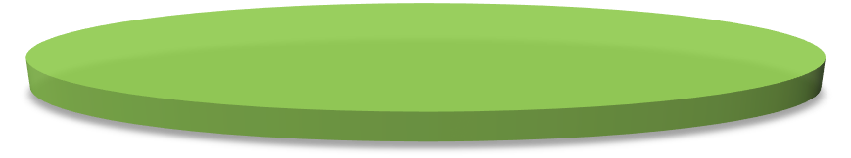

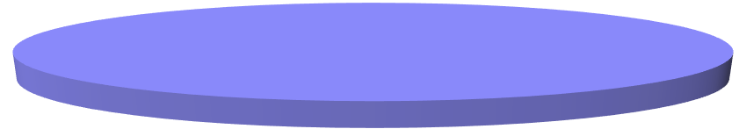
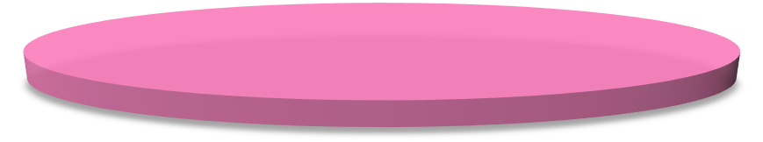
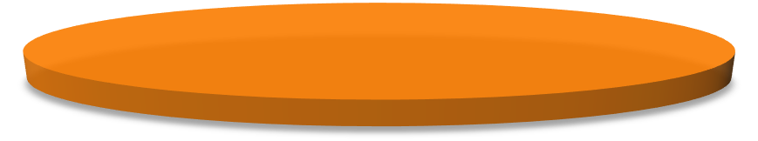
Architecture Building Blocks – High Level
Element relationships
Architectural elements
Architecture depth
Architecture layers
Programme
Standard
Capability
Operational
Service
System

Slide 6




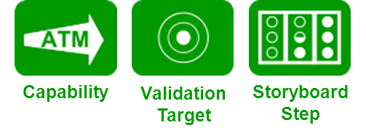
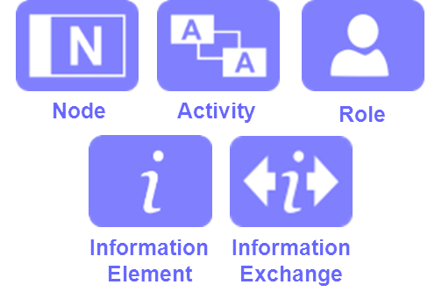


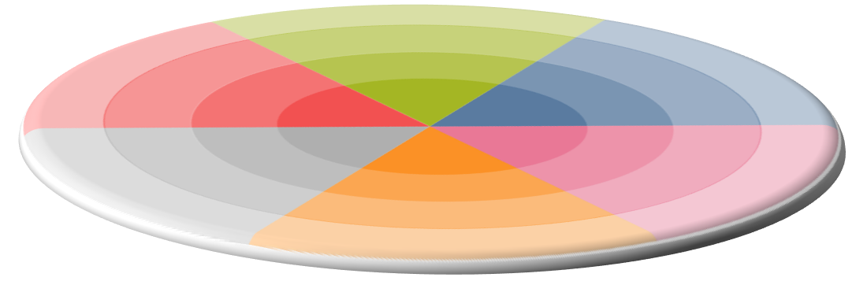







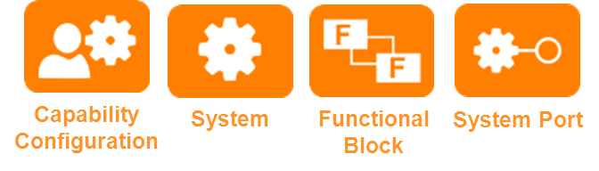
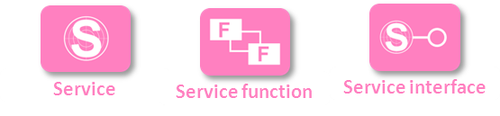
Change
Business
Operations
SESAR
Project
Operational
Focus Area
Operational Improvement
Step
Enabler
Standards
Standard
Systems / Resources
Information / Services

Slide 7







Informed Optimisation
Follow-on project defined in 2014 to establish the feasibility of
Identifying business optimisations from the architecture

Slide 8
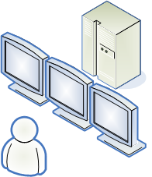
Capability – Service – Activity Relationship
Capability
Service
Consumer Activities
Achieves
Supports
Business Dimension
Provides Access to Capability via a Contract/SLA
Provider Activities
Operational Dimension
Provides Access to Information
Technical Dimension
Provides Access to Data
Physical Channel Supports Services
Resource
Resource

Slide 9
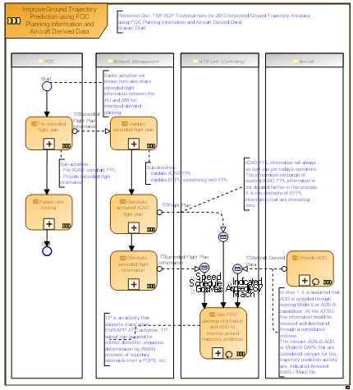

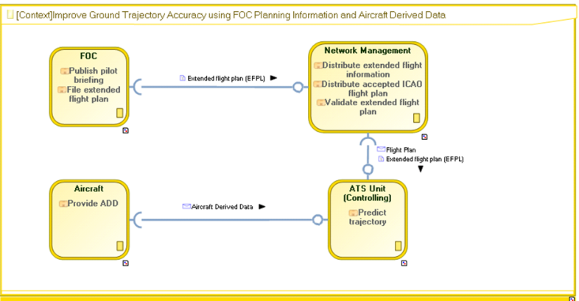
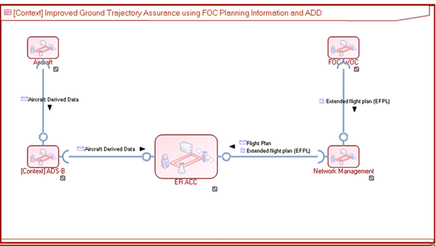

Information Exchange and Service
Information
Realise Node
NSV 2
NSV 1
Data
Channel

Slide 10
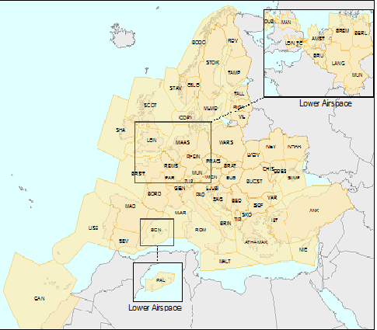
Current State – a fragmented picture
27 States each with a
unique service provider.
100+ Facilities across Europe
Each Service Provider
provides all services
The Cost of ATM Fragmentation has been estimated at 5 Billion Euros per annum
(European Commission)

Slide 11
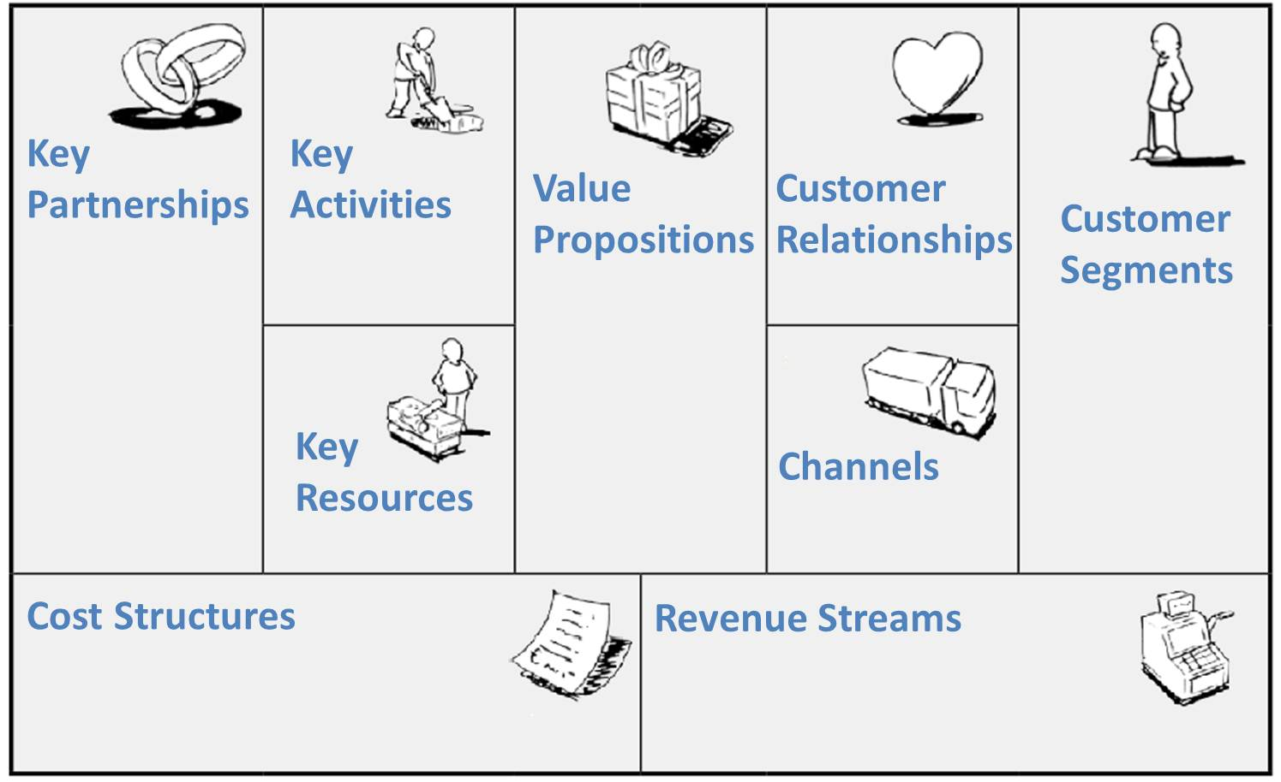
Business Model Canvas
BusinessModelGeneration.com

Slide 12
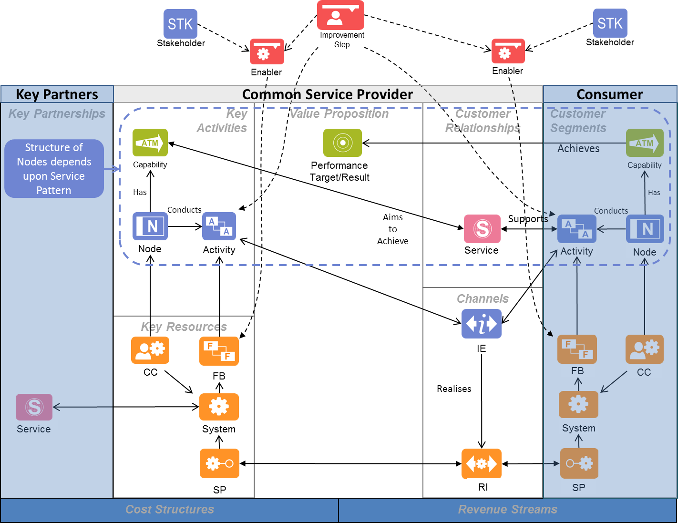
Common Service Representation in EATMA

Slide 13







Common Service- Global Surveillance
ADS-B/C
ADS-B
Common Service Provider

